Slide 1
Trip to Dlouhé Stráně
"The European Commission support for the production of this publication does not constitute an endorsement of the contents which reflects the views only of the authors, and the Commission cannot be held responsible for any use which may be made of the information contained therein."

Slide 2
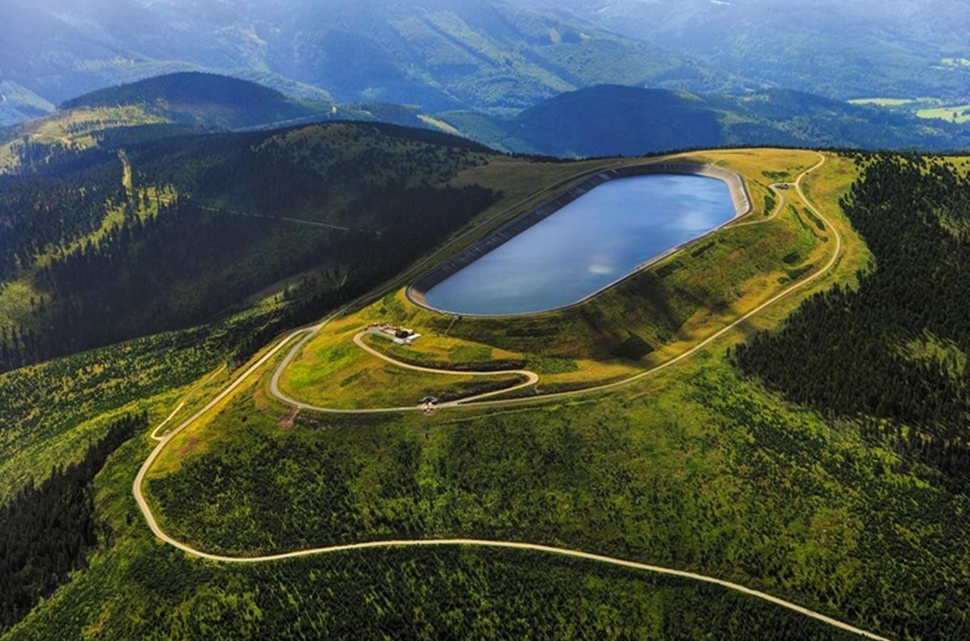
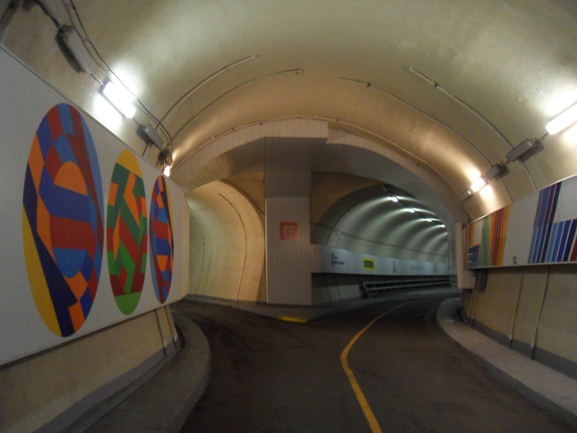
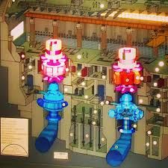
What we visited in Dlouhé Stráně?
We visited Dlouhé stráně, where is the third largest pump storage hydropower in the world, and the largest in Czech Republic.
It has the largest reversing water turbine in Europe.
Most of the buildings are hidden underground.

Slide 3
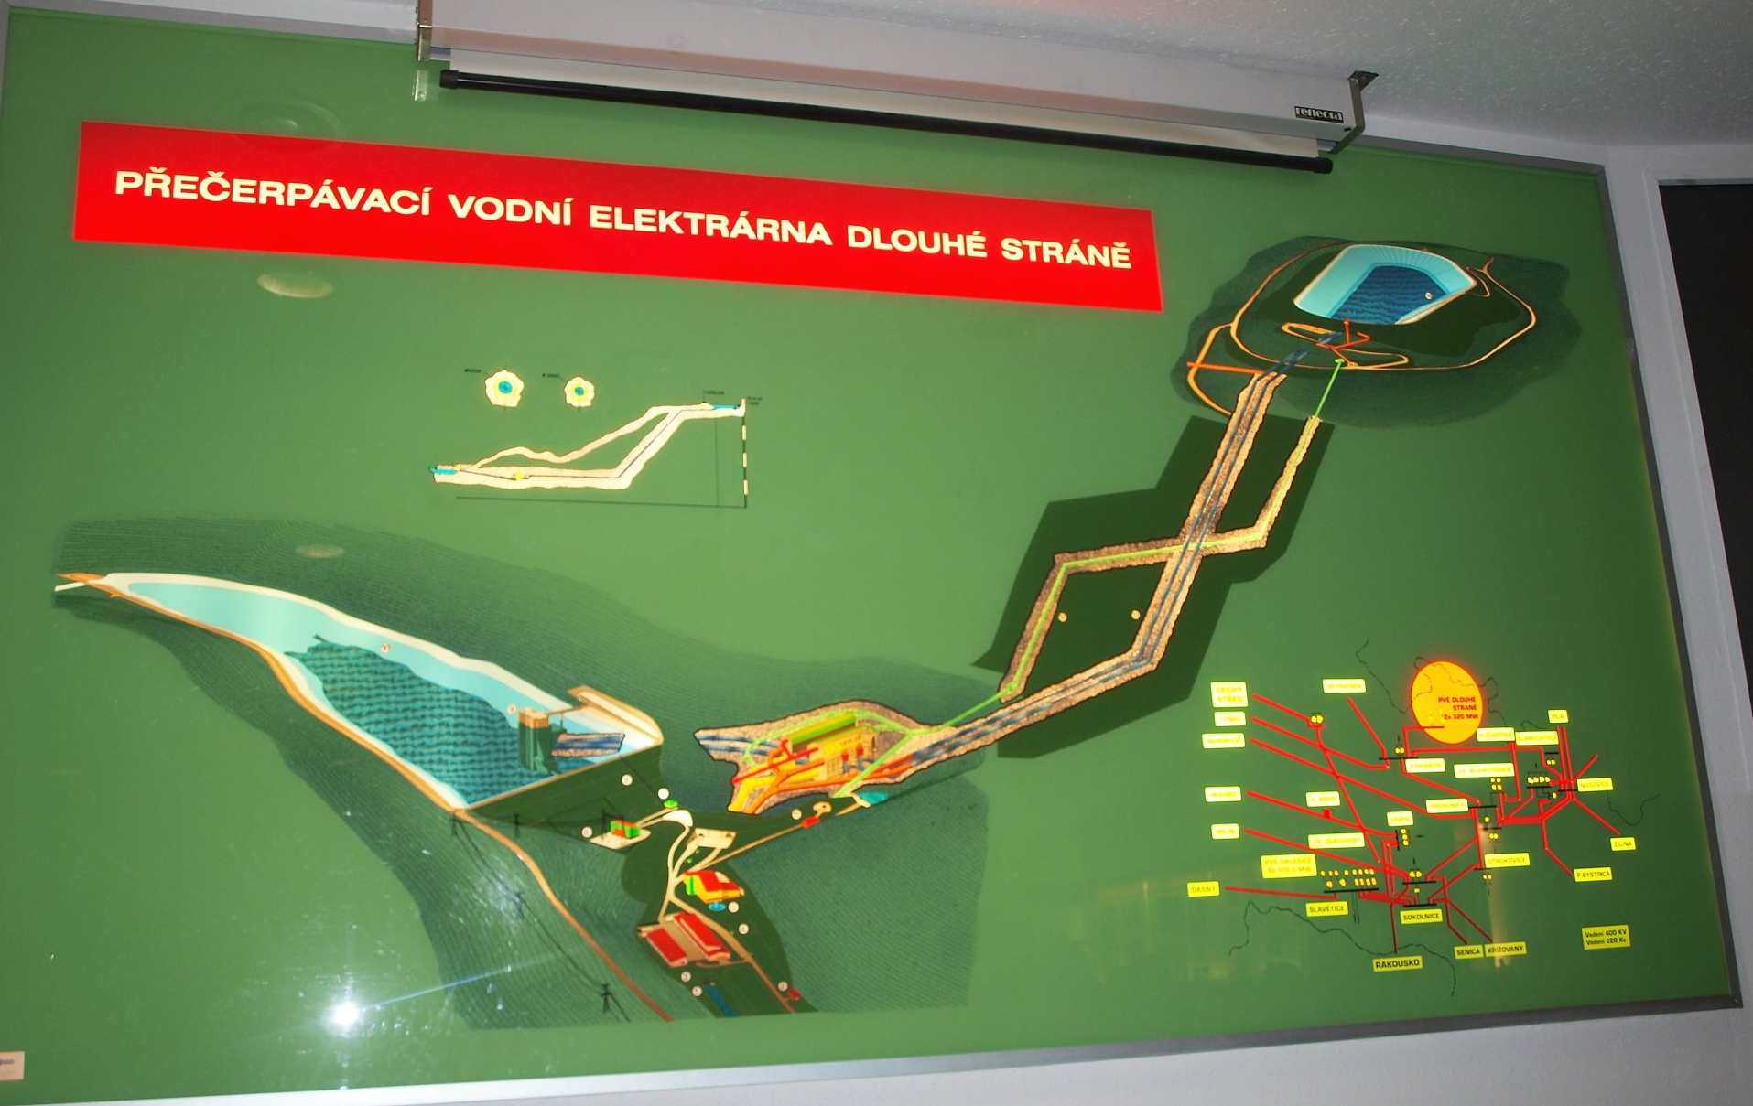
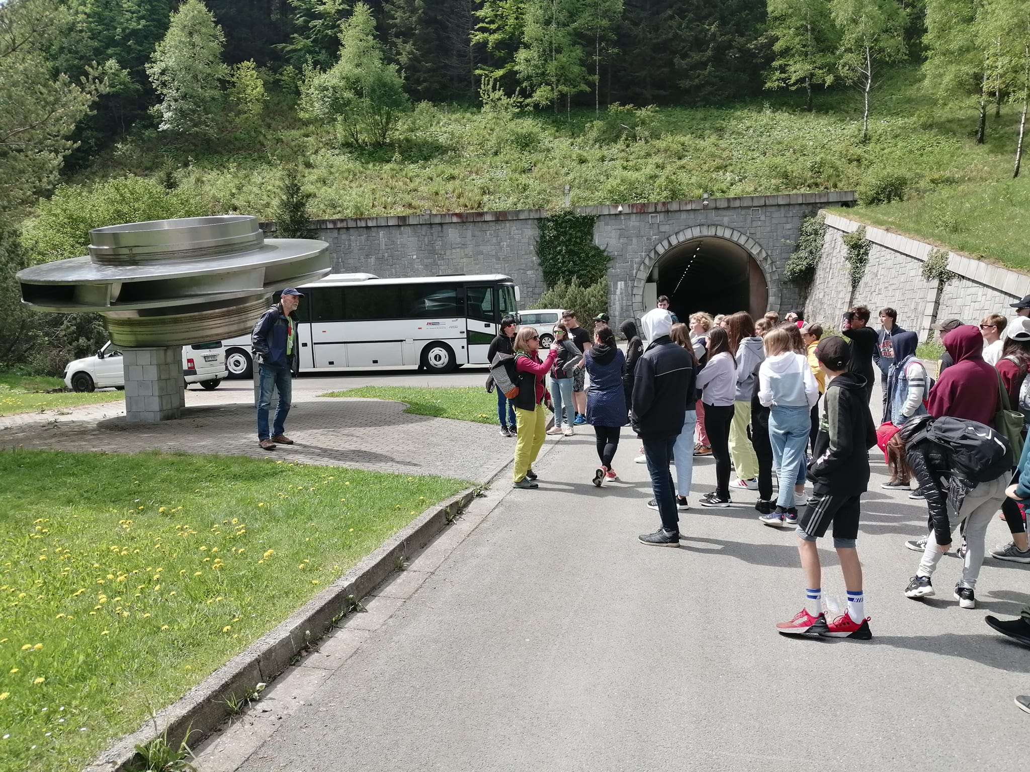
What we did on this trip?
It took us about 3 hours to get there from Holice by bus.
When we first get there, we saw a presentation about this hydro power station and how it works.
Next, we went to the underground part of the powe station, where we saw some workers and cars.

Slide 4
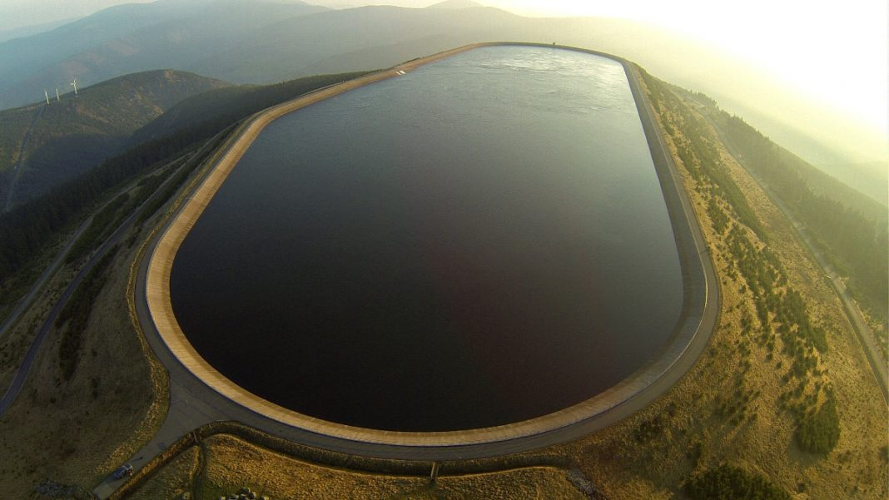
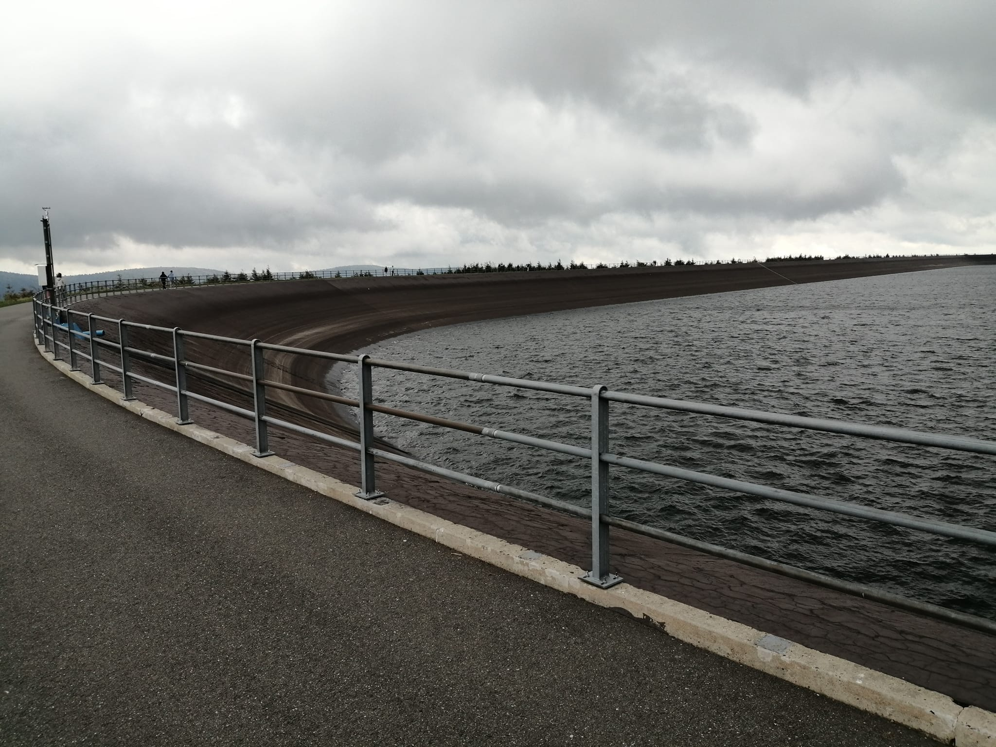
Visiting the lakes..
Then we continued by visiting both of these ,power lakes‘.
First we saw the bottom lake, witch was kinda boring.
But then, our bus took us to the top of the hill, on the top lake, witch was fun.
It was really windy and cold, but we could walk around the whole lake.

